Slide 1
CHIRURGIA BARIATRICA E FUNZIONE RENALE
RELATORE: Dott. Guido gembillo
Dirigente medico presso UOC Nefrologia e dialisi, AOU «G. Martino», Università degli studi di messina.
MD, Specialista in Nefrologia, PhD in Translational Molecular Medicine and Surgery, Abilitazione Scientifica Nazionale per il ruolo di Professore Associato Settore 06/D2
Endocrinologia, Nefrologia e Scienze dell’Alimentazione e del Benessere.

Slide 2
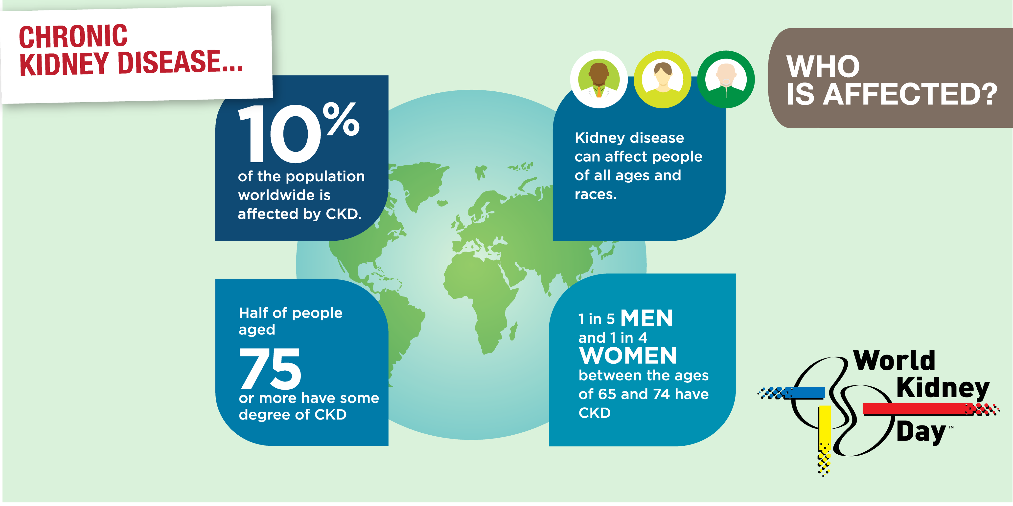
Chronic Kidney Disease Worldwide
There is an increase in the incidence of CKD, which is usually diagnosed relatively late when nephroprotective actions bring little benefit. For this reason, the number of people requiring RRT, including dialysis and kidney transplantation, is also increasing. CKD is divided into five stages according to the glomerular filtration rate (GFR). RRT is usually started when the GFR is lower than 15 mL/min/1.73 m² or earlier when it is accompanied by, among others, malnutrition, overhydration, and severe uremia.
Dott. Guido Gembillo

Slide 3
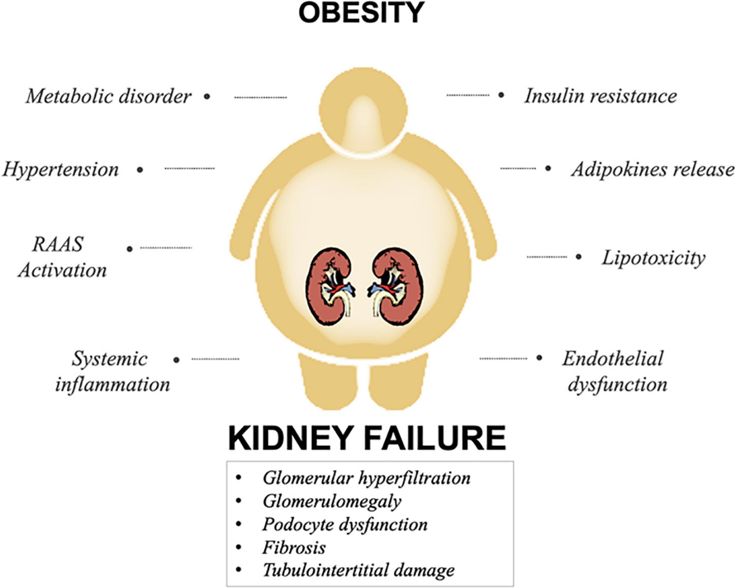
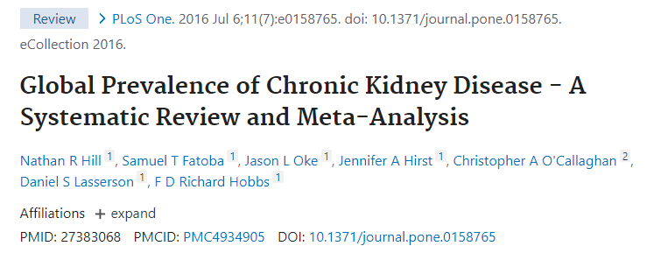
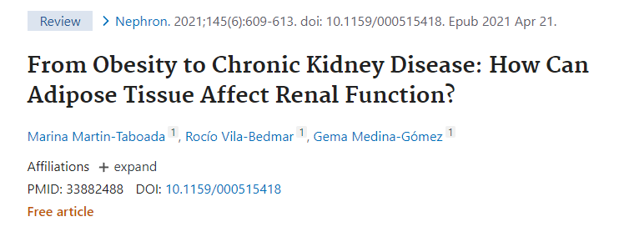
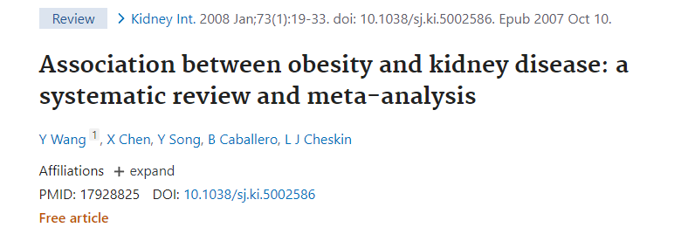
Obesity and CKD
Obesity contributes to chronic oxidative stress, inflammation, and renal fibrosis, leading to progressive kidney damage and the need for renal replacement therapy.
Obesity increases the risk of developing CKD, the incidence of which is 10.6% at stages 3–5. Studies show that CKD is more common than diabetes.
In observational studies, obesity has been associated with higher risk of incident CKD and end-stage renal disease, as well as nephrolithiasis and renal cell cancer.
Dott. Guido Gembillo

Slide 4
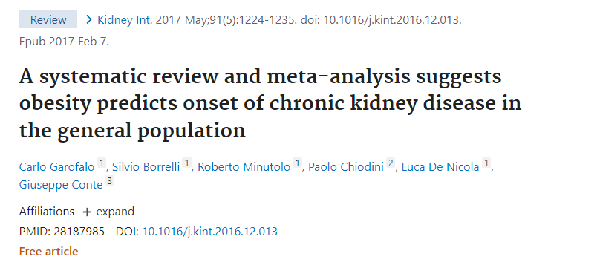
Obesity and CKD
A big meta-analysis of cohort studies, including 600,000 cases, assessed the effect of obesity on the CKD risk beyond its association with T2DM: obesity could be associated with a 51% increase in the risk of new-onset albuminuria and 18% in the risk of new onset of CKD stage 3 at 5 years.
In addition, obesity may accelerate the loss of function in a variety of renal conditions such as polycystic disease, IgA nephropathy, renal transplant, and diabetic renal disease
Dott. Guido Gembillo

Slide 5
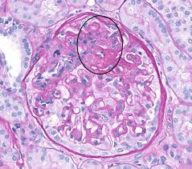
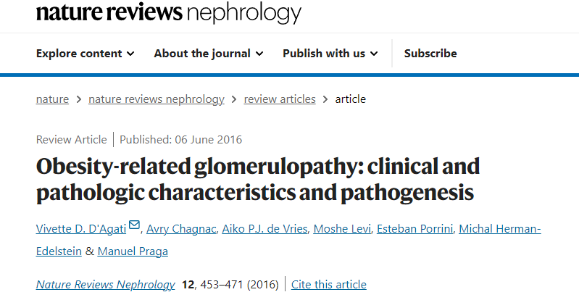
Obesity and CKD
Excess body weight leads to chronic inflammation, oxidative stress, lipotoxicity, and impaired adipokine secretion, which also adversely affects kidney function.
Obesity leads to functional and structural changes in the kidneys. Hyperfiltration and proteinuria, which are caused by glomerulosclerosis and tubulointerstitial fibrosis, are observed. These disorders are called obesity-related glomerulopathy (ORG)
Patients with obesity show glomerular hypertrophy associated with low glomerular density with or without a characteristic form of focal segmental glomerulosclerosis (FSGS), increased renal plasma flow (RPF), and glomerular filtration rate (GFR). In adaption to the glomerular expansion, podocyte increase in size but cannot keep up with it, leading to podocyte failure and detachment that results in an increase in glomerular permeability followed by lesions of FSGS.
Proximal tubular hypertrophy, with a higher cross-sectional area and its lumen, has been described in proteinuric obese individuals compared to non-obese patients with proteinuria.
Dott. Guido Gembillo

Slide 6
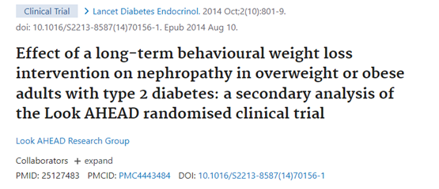
Obesity and CKD
The risk associated with obesity may be reversible: a randomized controlled trial of patients with type 2 diabetes demonstrated that weight loss decreased the risk of adverse CKD outcomes.
Dott. Guido Gembillo

Slide 7
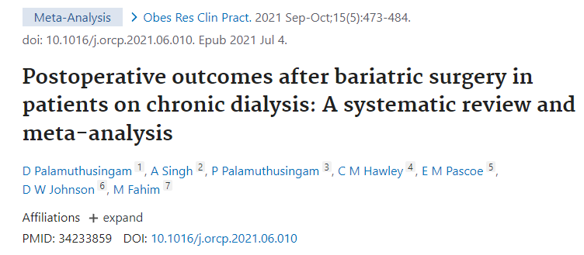
BS techniques in CKD patients
Among BS procedures, sleeve gastrectomy (SG) is most commonly performed in these patients, reflecting the overall trend in the generic BS population.
An advantage of SG is the lack of association with kidney stones or oxalate nephropathy and the lack of interference with absorption of immunosuppressive medications after KT, risks well recognized post Roux-en-Y gastric bypass.
Four cohort studies involving 4196 chronic dialysis and 732,204 non-dialysis patients undergoing bariatric surgery were included. Sleeve gastrectomy (61%), and Roux-en-Y gastric bypass (29%)
Dott. Guido Gembillo

Slide 8
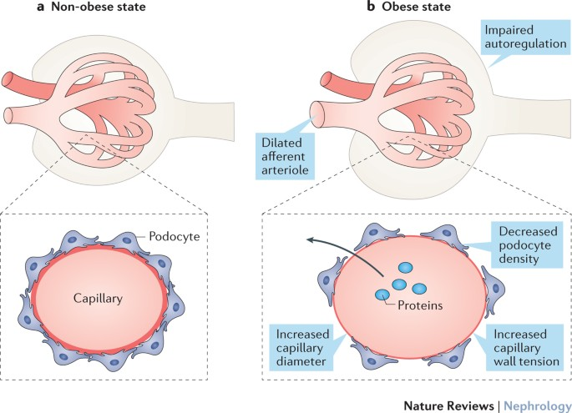
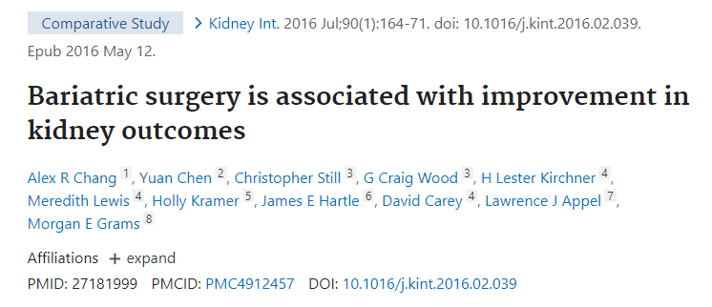
Renal Function after BS
Obese persons submitted to BS reduce in approximately 58% their decline of GFR by ≥30% and the risk of doubling serum creatinine at 5 years.
Dott. Guido Gembillo

Slide 9
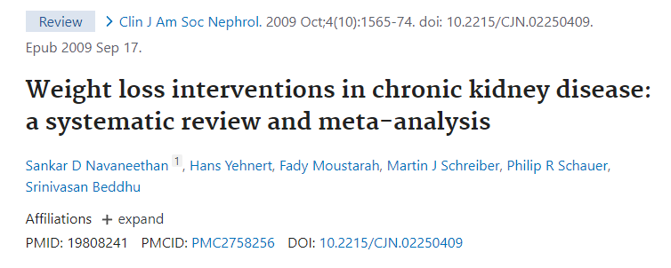
Effect of Bariatric Surgery on Kidney Function in Patients
In support of a beneficial effect of bariatric surgery on future renal risk, a number of studies and meta-analyses have shown that albuminuria and proteinuria decrease after bariatric surgery. Metabolic surgery, by reducing intraabdominal pressure, improves renal vein pressure, increases renal blood flow, and normalizes GFR, plasma renin activity, and aldosterone levels, all of them involved in proteinuria. Two case reports observed complete resolution of proteinuria after bariatric surgery in patients with obesity-related FSGS. However, all of these studies were of short duration (1−2 years), and often lacked comparison groups.
Dott. Guido Gembillo

Slide 10
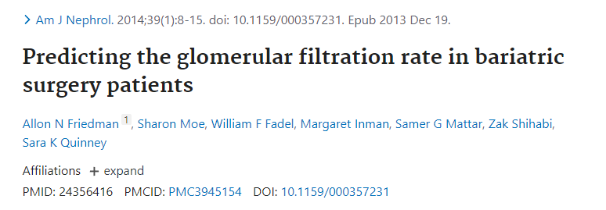
Filtration Markers in Estimating GFR After Bariatric Surgery
There are important limitations of all observational studies of kidney disease and bariatric surgery, including potential residual confounding and the use of creatinine-based eGFR, which correlates with muscle mass. Massive weight loss might result in overestimation of eGFR after bariatric surgery.
Friedman et al. measured GFR by iothalamate clearance, serum creatinine, and cystatin C in 33 patients with normal or supranormal kidney function. Cystatin C correlated better with mGFR than creatinine both before and after surgery, although neither had very good accuracy in estimating GFR alone. Use of the Chronic Kidney Disease Epidemiology Collaboration (CKD-EPI) combined creatinine-cystatin C equation estimated GFR within 30% of mGFR more than 80% of the time before and after surgery. This suggests that the use of multiple filtration markers could be beneficial in future research studying kidney function changes after bariatric surgery.
Dott. Guido Gembillo

Slide 11
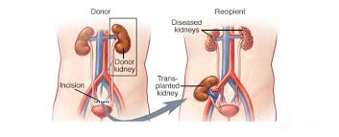
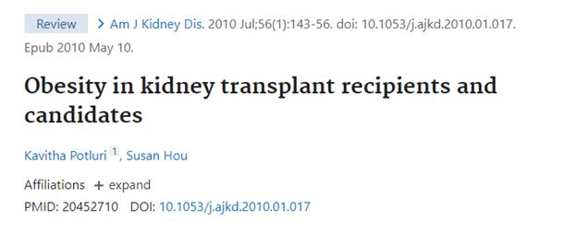
Role of BS Kidney Transplantation
Obesity may be an obstacle in qualifying for kidney transplantation. Both donors and transplant recipients may be disqualified due to excess body weight.
The body weight cut-offs that qualify for transplantation depend on the principles of the treatment center and the individual state of health of the patient. In most centers, BMI over 40 kg/m² is a contraindication to the procedure, and over 35 kg/m² is a relative contraindication.
The number of kidney transplant recipients with a BMI over 30 kg/m² doubles every 15 years. Obesity during transplantation is associated with poorer perioperative outcomes in terms of length of surgery and hospitalization, wound infections, delayed graft function, incisional hernia, and other complications.
Dott. Guido Gembillo

Slide 12
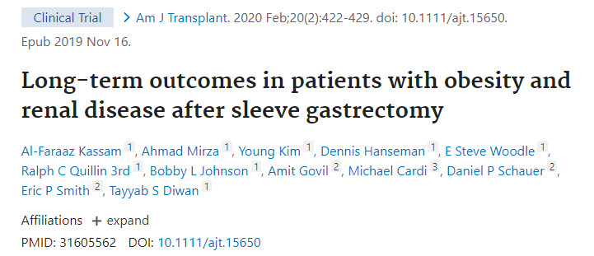
KTX Candidates
BS is performed on CKD patients treated conservatively, on dialysis, before and after kidney transplantation. Weight loss in the above-mentioned groups of patients brings positive effects. Rapid and sustained weight loss due to BS enables patients with ESRD to stop dialysis treatment and receive a transplant. Additionally, pre-transplant metabolic surgery may reduce the risk of mortality and graft failure. On the other hand, it increases the pool of people who can donate an organ. Weight loss slows disease progression in non-dialysis patients.
Dott. Guido Gembillo

Slide 13
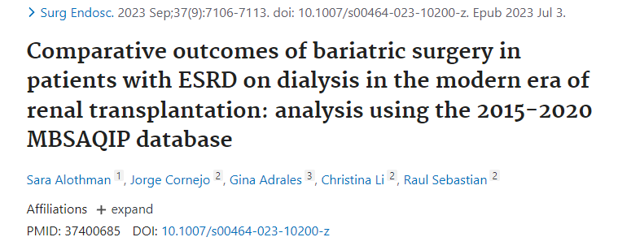
BS outcomes in Hemodialysis patients
SG has an overall low post-procedure mortality rate, albeit higher than in the general bariatric population (0.7% vs 0.3% 30-day mortality risk on patients on HD vs not, respectively; P = .02).
Importantly, however, the risk of death is 47% higher among the patients with CKD stage 5D in the first year post-procedure compared with well-matched non-SG controls. Although the mortality risk subsequently improves, better outcomes are mainly, but not exclusively, driven by the higher KT rates.
Patients who remain on HD continue to face high mortality risk (5-year cumulative incidence of 31.6% in patients post SG vs 44% nonsurgical controls).
Improving the overall health of these patients may lead to lower mortality and, subsequently, even higher transplant rates.
Dott. Guido Gembillo

Slide 14
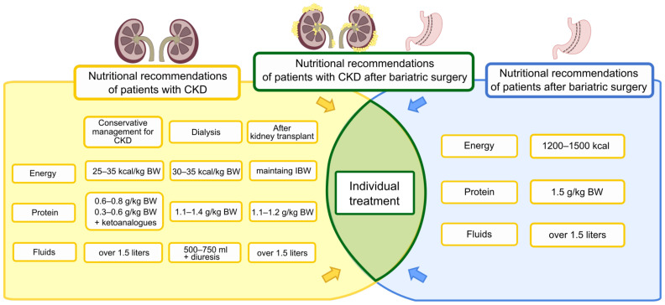
Nutritional recommendations after BS

Slide 15
Variable | No kidney disease | CKD stage 4-5 | CKD stage 5D (HD/PD) |  | CKD stage 5D (HD/PD)
Fluid intake | At least 2 L daily | Before SG: At least 2 L daily; individualized based on fluid status | Before SG: Up to 1000 mL/d above daily urine output to prevent large intradialytic volume gains |  | Before SG: Up to 1000 mL/d above daily urine output to prevent large intradialytic volume gains
 |  | After SG: At least 2 L daily, intravenous fluids may need to be given postoperatively to prevent dehydration Avoid fluid intake 30 min before or after each meal | After SG: Up to 1000 mL/d above daily urine output (required protein supplement drinks included) Limit additional fluids to prevent large intradialytic volume gains. Avoid fluid intake 30 minutes before or after each meal |  | After SG: Up to 1000 mL/d above daily urine output (required protein supplement drinks included) Limit additional fluids such as water to prevent large intradialytic volume gains Avoid fluid intake 30 minutes before or after each meal
Calories
 | After SG: 400-600 calories/d for up to the first month 600-900 calories/d for the next 2 months 1200 calories/d thereafter | After SG: up to 600-800 calories/d for the first 2 weeks Gradual increase up to 1200 calories/d thereafter or adjust as needed for desired weight loss |  |  | After SG: up to 800-1200 calories/d for the first 2 weeks At least 1200 calories/d thereafter or adjust as needed for desired weight loss
Protein | Before SG: 0.8 g/kg body weight daily | Before SG: 0.6 g/kg per day in non-diabetics 0.6-0.8 g/kg in diabetics |  |  | Before SG: 1.0-1.2 g/kg per day
 | After SG: Acute postop: 60-80 g daily or 1.1-1.5 g/kg of IBW daily Weight maintenance: 0.8 g/kg body weight daily | After SG: Acute postop: 60-80 g daily or 1.1-1.5 g/kg of IBW for healing after surgery Long term: 0.6-0.8 g/kg per day of IBW or ABW once resumes solid foods |  |  | After SG: Acute postop: At least 80 g daily or 1.1-1.5 g/kg of IBW for healing after surgery Long term: 1.0-1.2 g/kg per day once resumes solid foods
Sodium | <2300 mg/d; consider Na intake liberalization if hypotension is present and no clinical volume overload
K and P | Per RDA/DRI recommendations | Individualized to maintain serum levels within goal range
Calcium | Before SG: 1200-1500 mg/d After SG: 1500-2000 mg/d Take calcium supplements with meals in 2-3 divided doses | 800-1000 mg/d, if not taking vitamin D analogs |  |  | Adjust calcium intake with consideration of any vitamin D analogs to avoid hypercalcemia or calcification
Vitamin D | 2000 IU daily | Consider D2 or D3 supplement to correct insufficiency
Other vitamin/mineral supplements | Before SG: Per RDA/DRI recommendations | Before SG: Renal vitamin, if needed Oral iron, as needed |  |  | Before SG: Renal vitamin Intravenous iron, as needed
 | After SG: Monthly B12 injection Daily multivitamin/mineral, 200% of daily value in divided doses. Iron as needed | After SG: 1000 μg B12 injection monthly Iron, as needed

Slide 16
Conclusion
Bariatric procedures are more and more often used in patients with obesity and simultaneously with CKD.
In addition to standard procedures before and after bariatric surgery, there should be cooperation with a nephrologist.
It is also necessary to emphasize the role of an experienced dietician or nutritionist in the field of nutrition in nephrology.
Weight loss surgery in patients with CKD improves short-, medium-, and long-term kidney outcomes as well as obesity comorbidities. Consequently, BS could be considered as a renoprotective intervention in patients with pre-existing CKD and it should not be discouraged depending on CKD etiology.
BS is of pivotal importance for KT potential recipients with high BMI.
Nevertheless, these potential benefits must always be counterbalanced with eventual adverse events in multidisciplinary teams. Additional surgical risks should always be considered in order to be prepared and therefore avoid a negative impact not only on hospital length of stay but also complications and survival rate.
Dott. Guido Gembillo

Slide 17
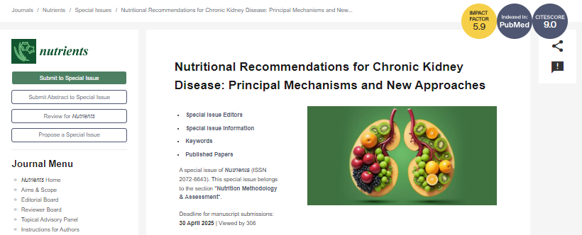
Call for Papers!
email: guidogembillo@live.it
Dott. Guido Gembillo

Slide 18
Grazie per l’attenzione
Dott. Guido Gembillo
Email: guidogembillo@live.it

